Slide 1
HOSTEL DATABASE MANAGEMENT SYSTEM

Slide 2
PRESENTED BY MAREEDHU ARAVINDH - 421217 TANGUDU PREMSAI - 421262
PRESENTATION DATE 15-04-2023

Slide 3
CONTENTS
ABSTRACT
INTRODUCTION
EXISTING SYSTEM
PROPOSED SYSTEM
ENTITIES
ER MODEL
RELATIONAL SCEMA
NORMALIZATION
INTEGRITY CONSTRAINTS
CONCLUSION

Slide 4

ABSTRACT

Slide 5
ABSTRACT
The Hostel Database Management System is a application designed to manage the management of hostels. The system is developed to manage the room allocation, billing and payments, inventory management, Local and Non-local outings, and security of the hostel and it allows students to reserve rooms online, receive confirmation and check-in details by email or text message. The system also provides easy access to important information such as hostel rules and regulations, emergency contacts and takes student feedback which help to identify areas of improvement and make data-driven decisions. The system allows to admin to access the student details as well as employee details can check all the data in the system and it automates many manual tasks and reduces the workload of administrative staff, increasing efficiency and accuracy.
Overall, the hostel Database management system is designed to improve the student experience, increase efficiency, and enhance the security of the hostel.

Slide 6

INTRODUCTION

Slide 7
INTRODUCTION
Hostel Management system is a web application developed for managing the various operations of hostel, including Room registration, student details, local and Non-local outings details , employee details, billing and payments . The main objective of this mini project is to develop a simple and user-friendly hostel management system that can help hostel administrators manage their daily tasks more efficiently

Slide 8

EXISTING SYSTEM

Slide 9
EXISTING SYSTEM
The existing system of the hostel management system involves manual methods of managing the day-to-day operations of the hostel. The hostel manager or administrator has to manage all the data related to the students residing in the hostel, including their personal information, room allocation, mess charges, and other details. The manual system leads to inefficiencies, inaccuracies, and a lack of transparency. It can also cause delays in handling the various hostel-related tasks, leading to increased workloads

Slide 10
PROPOSED SYSTEM

Slide 11
PROPOSED SYSTEM
The proposed system of the hostel management system involves a computerized system that automates all the hostel-related operations. The system has features to manage student records, room allocation, and other related tasks. It provides a user-friendly interface for the hostel manager to manage all the data related to the hostel. It also enables students to access their records and make requests related to hostel services. The proposed system is designed to reduce the workload of the hostel manager and improve the efficiency of the hostel operations. It also provides a transparent and secure platform for managing hostel-related tasks

Slide 12

ENTITIES

Slide 13

ENTITIES
ADMIN
STUDENT
EMPLOYEE
BLOCK
ROOM
LOCAL OUTING
NON-LOCAL OUTING
FEE

Slide 14

ER MODEL

Slide 15
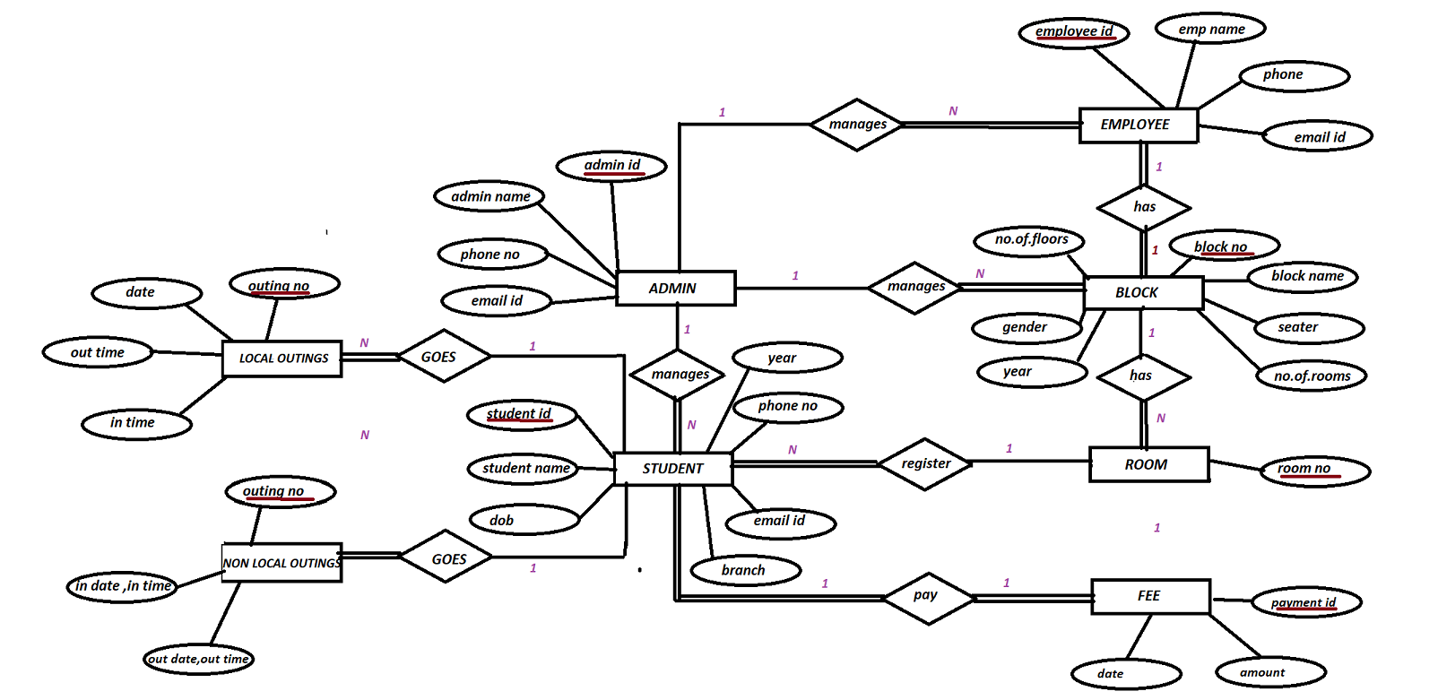
ER MODEL
N

Slide 16

RELATIONAL SCEMA

Slide 17

RELATIONAL SCEMA
ADMIN
STUDENT
EMPLOYEE
BLOCK
ROOM
LOCAL OUTING
NON-LOCAL OUTING
FEE
Admin_id | Admin name | Phone no | Email id
Student id | Student name | DOB | PHONE NO | EMAILID | YEAR | BRANCH
Emp_id | Emp name | phone | empid
Block_no | Block name | seater | No.of.rooms | No.of.floors | gender | year
Room no
Outing_no | date | Out time | In time
Outing_no | In date , in time | Out date , out time
Payment_id | amount | date

Slide 18
NORMALIZATION

Slide 19
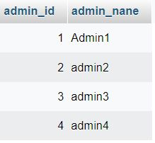
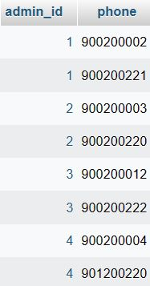
NORMALIZATION
Since mobile number is multi valued separate table is formed to maintain 1NF
Admin 1
Here PART KEY does not exist so there is no PARTIAL DEPENDENCY so it is in 2NF
Admin 2
Here no non-key determines non-key it is not TRANSITIVE DEPENDENDCY so it in 3NF

Slide 20
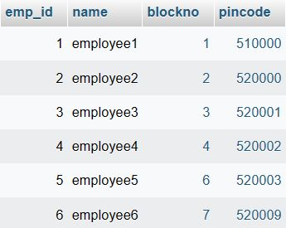
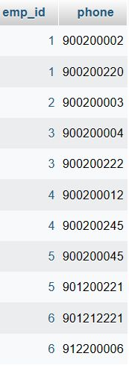
Employee
Employee 1
Since mobile number is multi valued separate table is formed to maintain 1NF
Here there is no PART KEY there is no partial dependency, so it is 2NF
Here there is no NON-KEY determines NON-KEY , so there is no TRANSITIVE DEPENDENCY , so it is 3NF

Slide 21
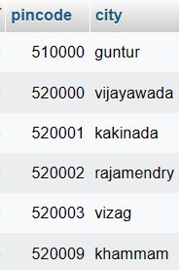
As in employee table pin-code determines city where non key determines non key which is a transitive dependency so creating a separate table will be in 2NF
City

Slide 22
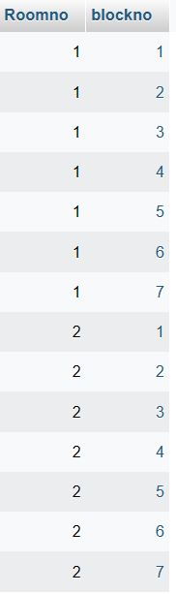
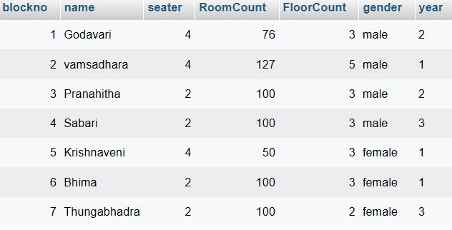
Blocks
Here there is no MULTI-VALUEDED, so it is in 1NF
Room
Here there is no NON-KEY determines NON-KEY , so it is not in TRANSITIVE DEPENDENCY, so is in 3NF

Slide 23
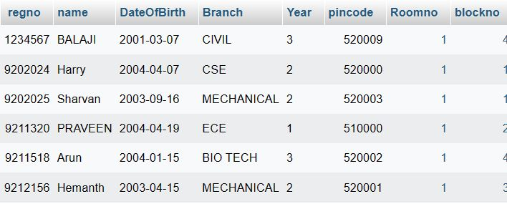
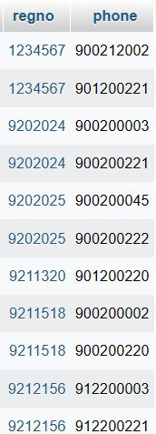
Student
Student 1
Since mobile number is multi valued separate table is formed to maintain 1NF
Here PART KEY does not exist so there is no PARTIAL DEPENDENCY so it is in 2NF
Here there is no NON-KEY determines NON-KEY , so there is no TRANSITIVE DEPENDENCY , so it is 3NF

Slide 24
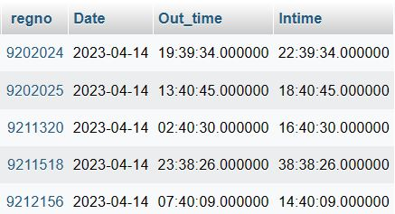
Local outings

Slide 25
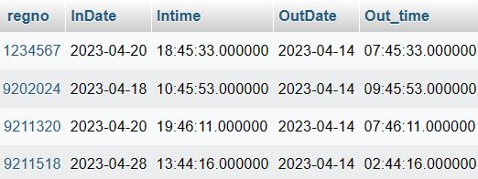
Non-Local outings

Slide 26
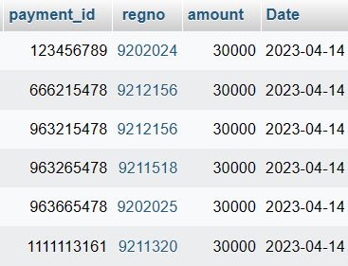
Fee

Slide 27
NORMALIZATION
Normalization is the process of organizing the data in the database.
Normalization is used to minimize the redundancy from a relation or set of relations. It is also used to eliminate undesirable characteristics like Insertion, Update, and Deletion Anomalies.
Normalization divides the larger table into smaller and links them using relationships.
The normal form is used to reduce redundancy from the database table.
Types
1NF : contains atomic value
2NF : A relation will be in 2NF if it is in 1NF and all non-key attributes are fully functional dependent on the primary key.
3NF : A relation will be in 3NF if it is in 2NF and no transition dependency exists.
BCNF : A stronger definition of 3NF is known as Boyce Codd's normal form.
4NF : A relation will be in 4NF if it is in Boyce Codd's normal form and has no multi-valued dependency.
5NF : A relation is in 5NF. If it is in 4NF and does not contain any join dependency , joining should be lossless.

Slide 28

INTEGRITY CONSTRAINTSE

Slide 29

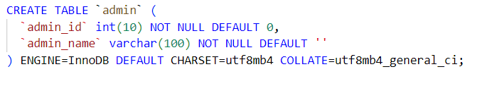
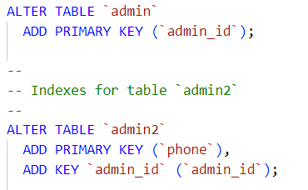
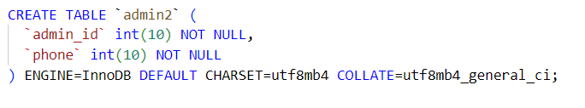
INTEGRITYCONSTRAINTS

Slide 30
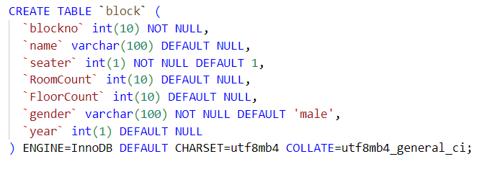
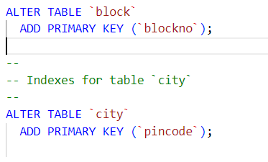
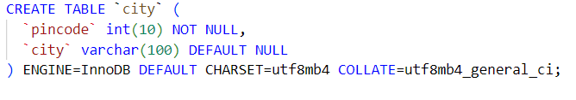
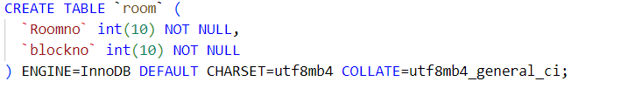


Slide 31
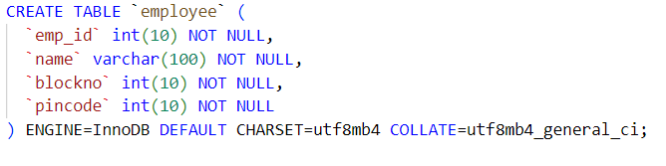
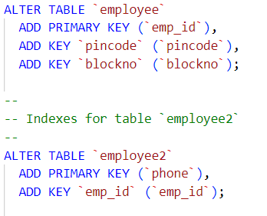
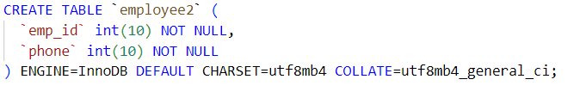

Slide 32
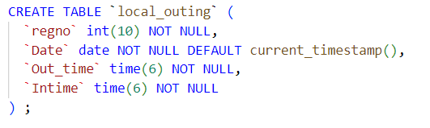
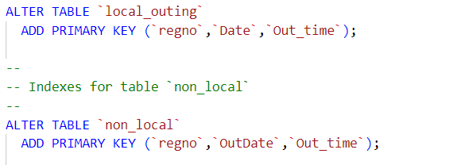
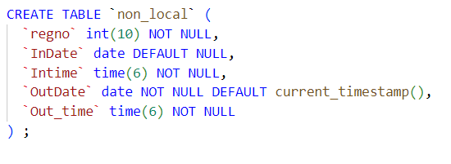

Slide 33
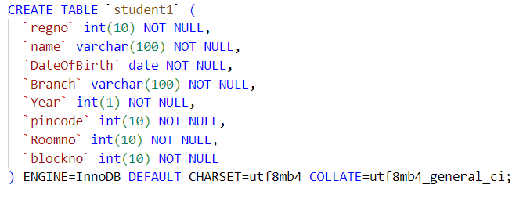
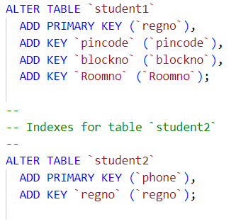
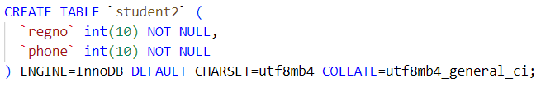
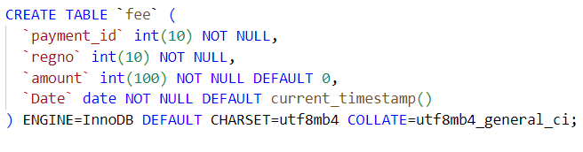


Slide 34
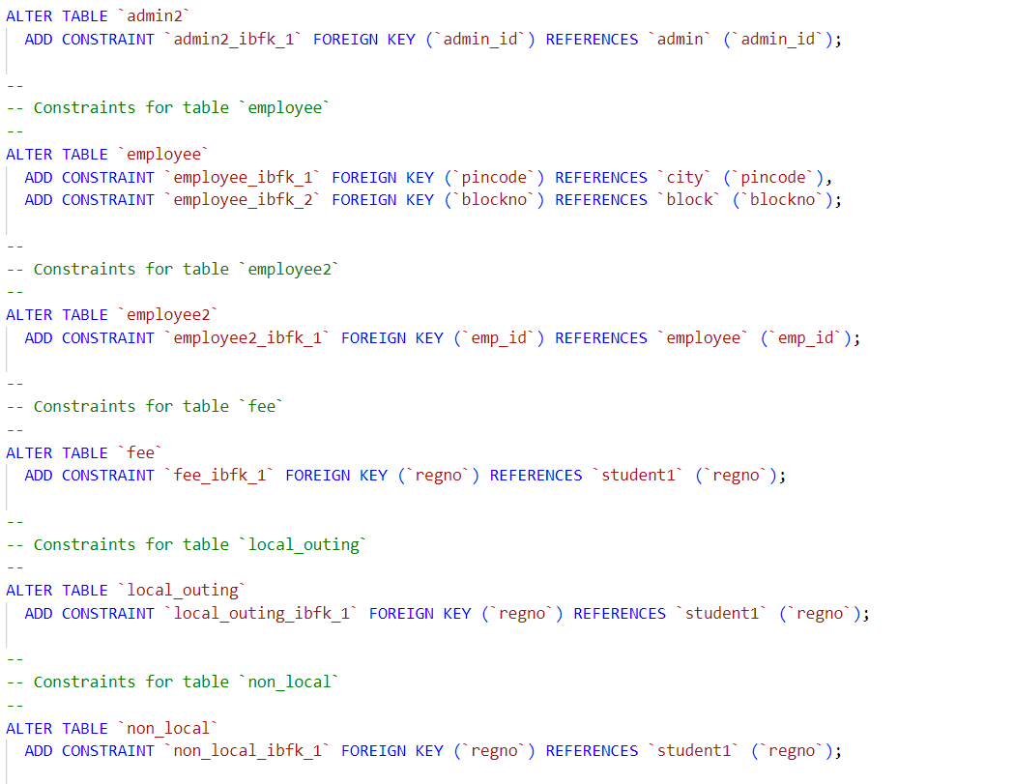
REFERENTIAL CONSTRAINTS

Slide 35
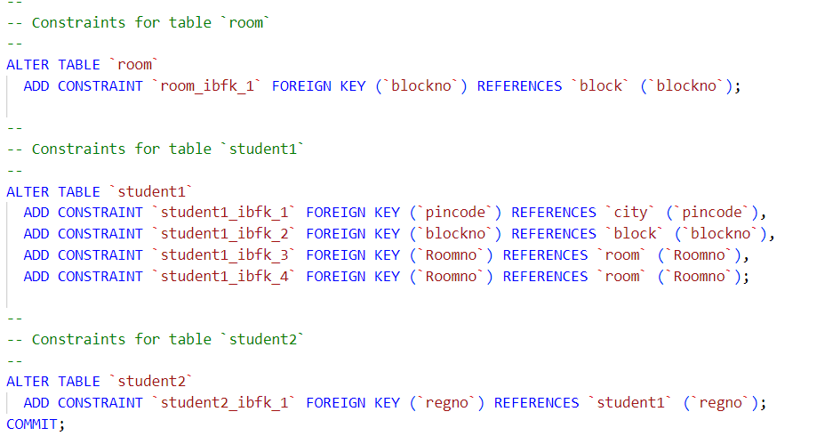

Slide 36

CONCLUSION

Slide 37
CONCLUSION
To conclude the description about the project, the project, developed using php with MySQL & XAMPP is based on the requirement specification of the user and the analysis of the existing system, with flexibility for future enhancement. HOSTEL MANAGEMENT SYSTEM is very useful for hostel allotment .This hostel management software is designed for people who want to manage various activities in the hostel. For the past few years the numbers of educational institutions are increasing rapidly Thereby the numbers of hostels are also increasing for the accommodation of the students studying in this institution. And hence there is a lot of strain on the person who are running the hostel and software’s are not usually used in this contex. This particular project deals with the problems on managing a hostel and avoids the problems which occur when carried manually. Identification of the drawbacks of the existing system leads to the designing of computerized system that will be compatible to the existing system with the system which is more user friendly.

Slide 38
Thank you

